Slide 1
Pruning of Ensemble CME modeling using Interplanetary Scintillation and Heliospheric Imager Observations
A. Taktakishvili, M. L. Mays, L. Rastaetter, M. Kuznetsova,
and
P. K. Manoharan
Science for Space Weather, Jan 24 – 29, 2016, Goa, India

Slide 2
Ensemble Modeling of CMEs at CCMC/SWRC

Slide 3
Ensemble Modeling
Ensemble modeling is used in weather forecasting to quantify prediction uncertainties and determine forecast confidence
Individual forecasts which constitute an ensemble forecast represent possible scenarios that approximate a probability distribution which reflects forecasting uncertainties.
Uncertainties can be from initial conditions, observation error, and techniques and models.
Different forecasts in the ensemble can start from different initial conditions and/or be based on different forecasting models/procedures.
Provides a quantitative description of the forecast probability that an event will occur by giving event occurrence predictions as a percentage of ensemble size (probabilistic forecast).
Conveys the level of uncertainty in a given forecast in contrast to a categorical yes/no forecast (with only two probabilities, zero and one).

Slide 4
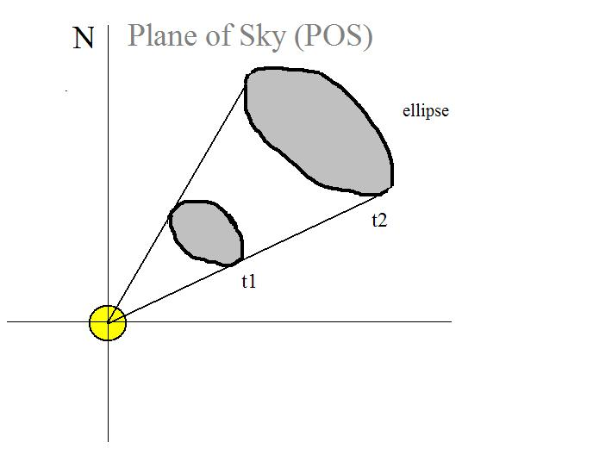
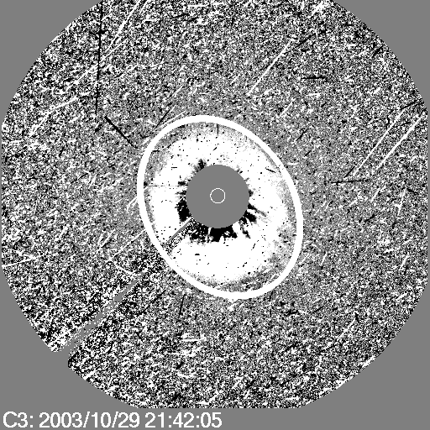
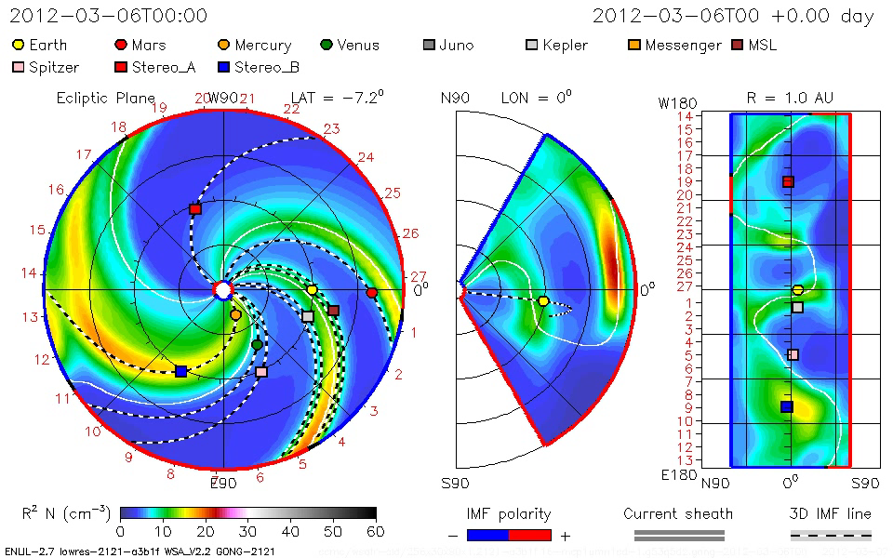
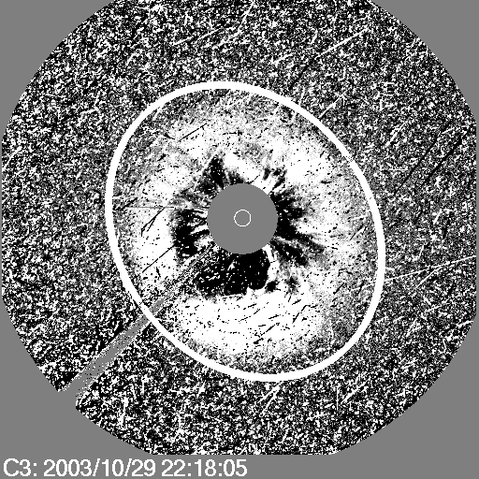
Cone Model Concept
Zhao et al, 2002, Cone Model:
CME propagates with nearly constant angular width in a radial direction
CME Parameters: input to WSA-ENLIL+Cone Model
1 set of input parameters – 1 modelling result, no estimate of uncertainty level, no probabilistic forecast.

Slide 5
Ensemble Modeling with WSA-ENLIL+Cone
Measure a set of n CME input parameters. Typically n=36 to 48 provides an adequate spread of input parameters, and this number can be increased as needed.
These are used as input to an ensemble of n WSA-ENLIL+Cone model runs.
This gives an ensemble of n profiles of MHD quantities and n CME arrival time predictions at locations of interest.
At Earth, n Kp estimates are made using WSA-ENLIL+Cone model plasma parameters as input to the Newell et al. (2007) coupling function for three IMF clock angle scenarios (Θ_{C}=90°, 135°, and 180°).
For n=48, an average run takes ~80 minutes on a cluster (using 128 processors).

Slide 6
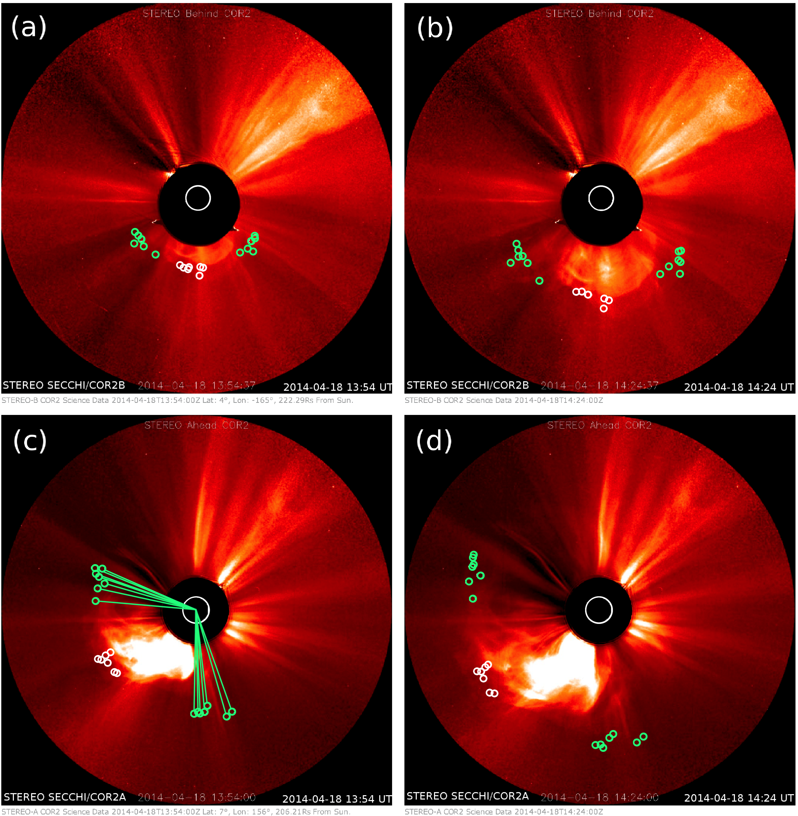
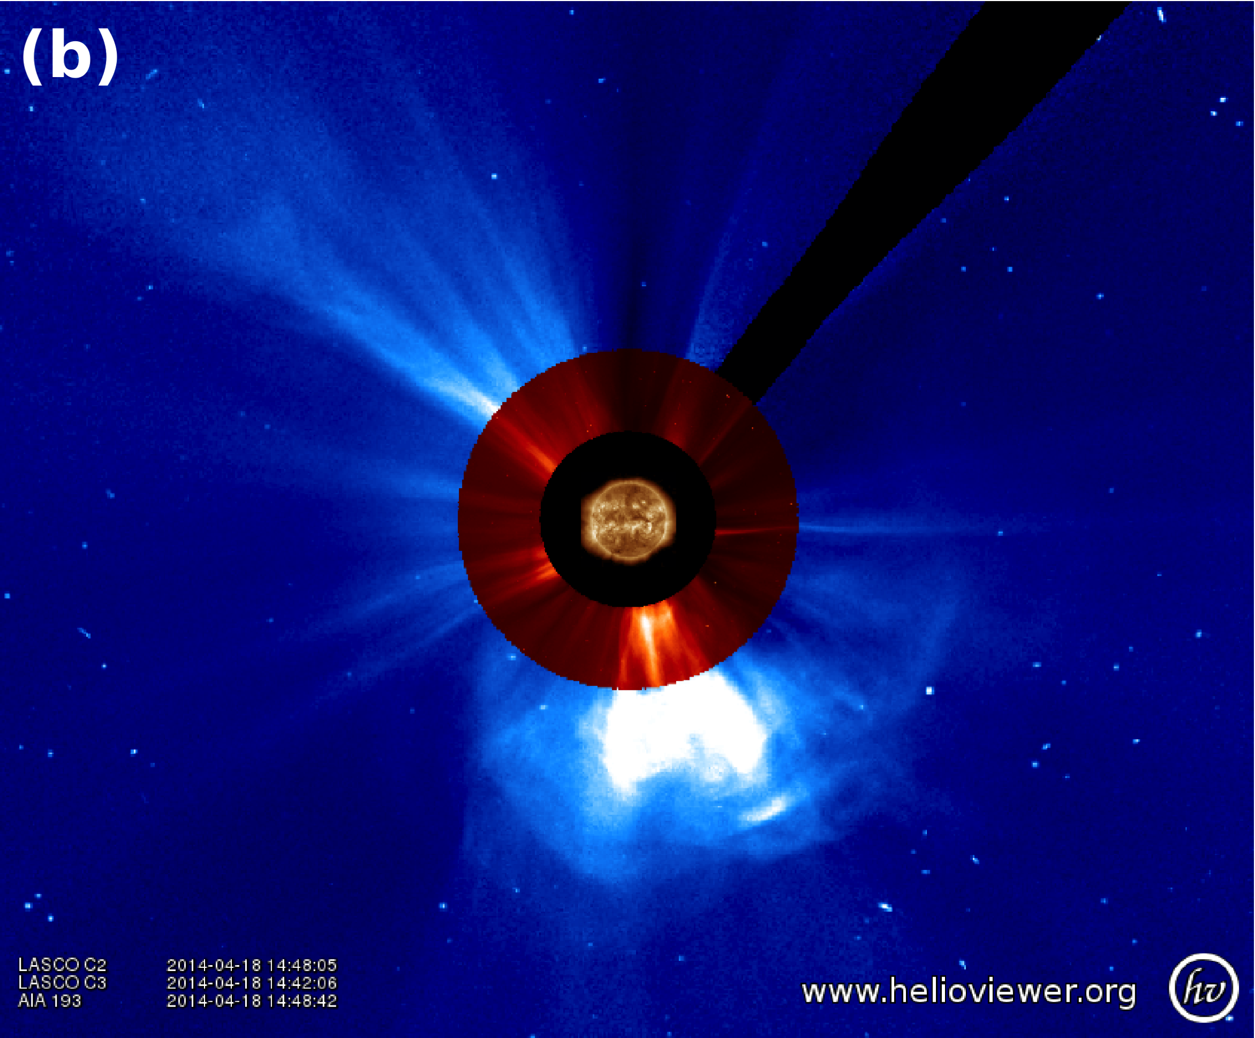
Example ensemble simulation: 18 April 2014 CME
Halo CME associated with M7.3 flare, coronal wave visible south of the AR
Ensemble of input CME parameters obtained by measuring the same feature using StereoCAT, which employs geometric triangulation techniques.
Notes:
Earth-directed partial halo CME that was first observed at 13:09 UT on 18 April 2014 by by SECCHI/COR2A. This CME was associated with an M7.3 class solar flare from Active Region 12036 located at S18°W29° with peak at 13:03 UT.
Eruption and a coronal wave were visible south of the AR in SDO/AIA 193 Å and a nearby filament eruption was visible in AIA 304Å.
Subsequently starting at 13:35 UT, an increase in solar energetic particle proton flux above 0.1 pfu/MeV observed by GOES Earth orbit.
Ensemble of input CME parameters obtained by measuring the same feature using StereoCAT which employs geometric triangulation techniques. The circles indicate the 6 individual leading edge (white circles near the center of the CME front) and width measurements (green circles marking the CME edges). The leading edge measurements (central circles) are later combined together to generate 6²=36 ensemble members.

Slide 7
18 April 2014 CME:
WSA-ENLIL+Cone modeled magnetic field, velocity, density, and temperature profiles at Earth for 36 ensemble.
Clear ICME arrival with enhanced post-shock temperatures, enhanced magnetic field with rotations in direction, and declining solar wind speed.
Observed CME arrival
Notes:
18 April 2014 CME:
WSA-ENLIL+Cone modeled magnetic field, velocity, density, and temperature profiles at Earth for 36 ensemble members (traces color coded by input speed), with the observed in-situ L1 observations from ACE (black, red for Bz).
Observations show clear signatures of the arrival of an ICME, including a leading shock (abrupt increase in all the solar wind parameters at around 10:20 UT) with enhanced post-shock temperatures, enhanced magnetic field with rotations in direction, and declining solar wind speed.

Slide 8
18 April 2014 CME: Histogram distribution of arrival time predictions at Earth
Mean predicted arrival: 20 April 2014 05:07 UT
Spread: 20 April 2014 01:05 to 11:15 UT.
100% arrival
likelihood
-5.2 hours prediction error for average predicted CME arrival
Notes:
Shows a normal distribution with 50% of the predicted arrivals within one hour of the mean.
The prediction error Δt_{error}=t_{predicted}-t_{observed} for the mean predicted CME arrival time was -5.2 hours and the observed arrival time was just within the ensemble predicted spread.

Slide 9
18 April 2014 CME: Distribution of Kp probability forecast
Kp =5
observed
Kp is forecast using ENLIL predicted solar wind quantities at Earth as input to the Newell et al. (2007) coupling function for three clock angle scenarios (Θ_{C}=90°, 135°, and 180°) and all three angles combined, assuming equal likelihood.
Observed Kp: 5 during period 12:00-15:00 UT on 20 April.
84% of the forecasts fall between Kp = 5 to 7. The most likely forecast is for Kp=7 at 41%, followed by Kp=5 at 27% and Kp=6 at 16% likelihood of occurrence.
Notes:
Kp is forecast using ENLIL predicted solar wind quantities at Earth as input to the Newell et al. (2007) coupling function for three clock angle scenarios (Θ_{C}=90°, 135°, and 180°) and all three angles combined, assuming equal likelihood.
The observed Kp index reached 5 during the synoptic period 12:00-15:00 UT on 20 April associated with the CME shock arrival.
84% of the forecasts fall between Kp = 5 to 7. The most likely forecast is for Kp=7 at 41%, followed by Kp=5 at 27% and Kp=6 at 16% likelihood of occurrence.
Using the most likely forecast of Kp=7, the prediction error is Kp_{error}= Kp_{predicted}- Kp_{observed} = 2 (overprediction)

Slide 10
Can real time IPS observations improve ensemble modeling results?
Pruning of Ensemble modeling using Ooty Radio Telescope IPS observations

Slide 11
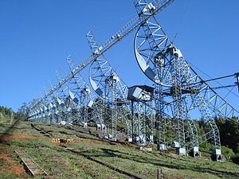
IPS observations from Ooty Radio Telescope
With the availability of year-round IPS observations from many distant radio sources it is possible to obtain images of heliospheric density to track the propagation of CMEs in the heliosphere starting at ¼ AU.

Slide 12
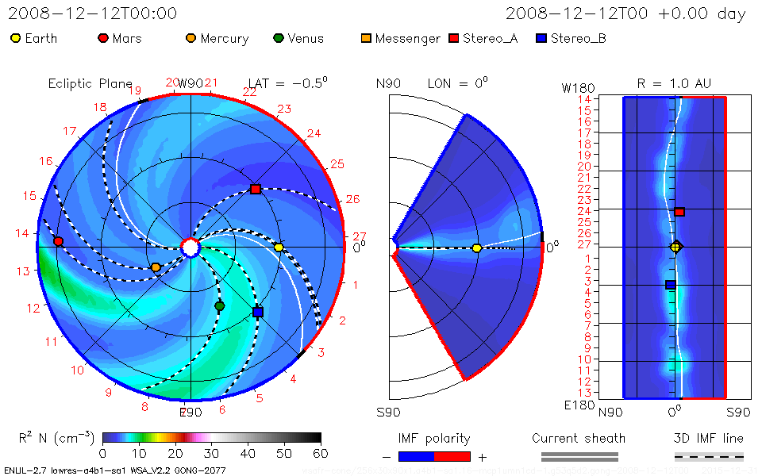
2008-12-12 CME: two different
members of the ensemble
member #1
member #10

Slide 13
Pruning of the Ensemble simulation
If, say at ½ AU, we can observe it’s track in the heliosphere, we can get rid of wrong ensemble members and improve the prediction accuracy!

Slide 14
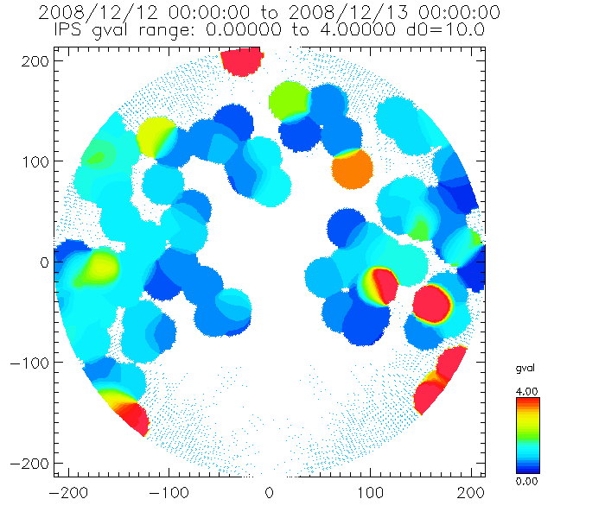
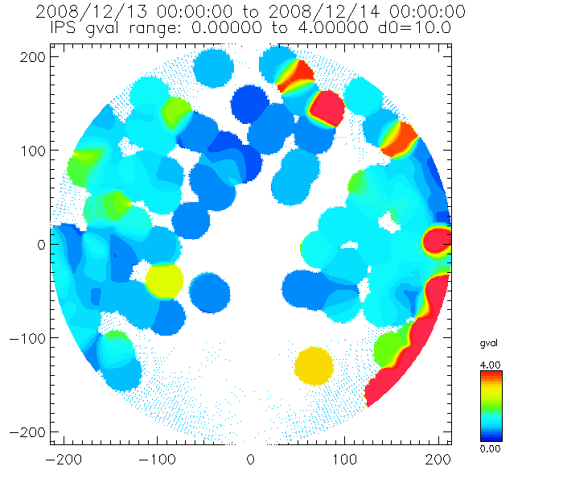
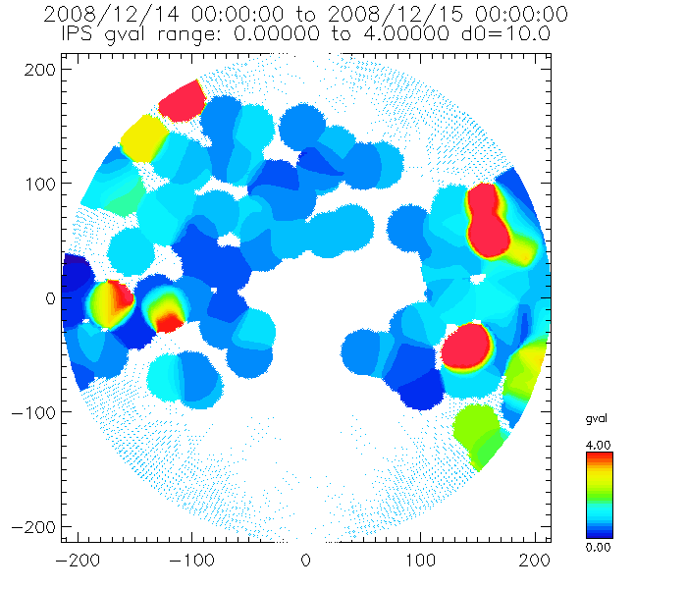
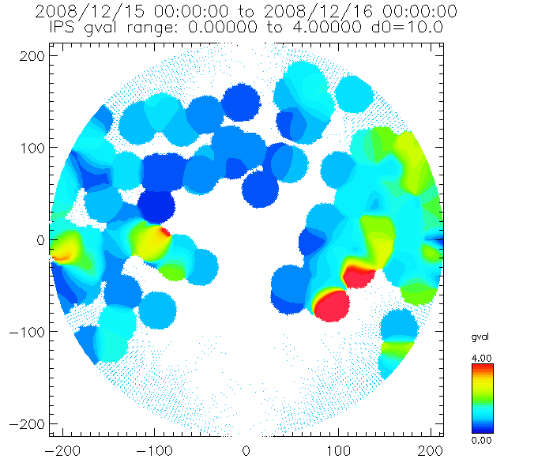
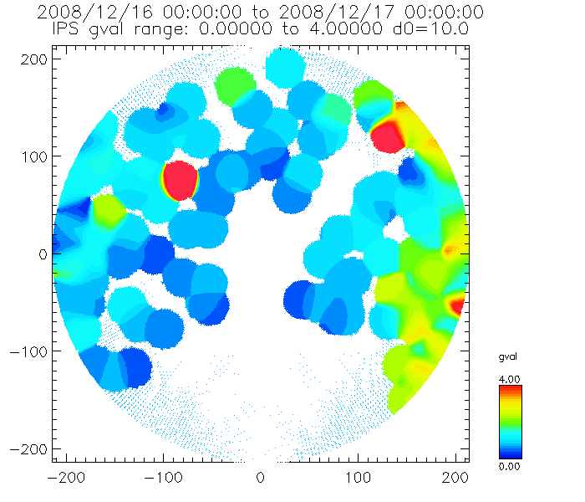
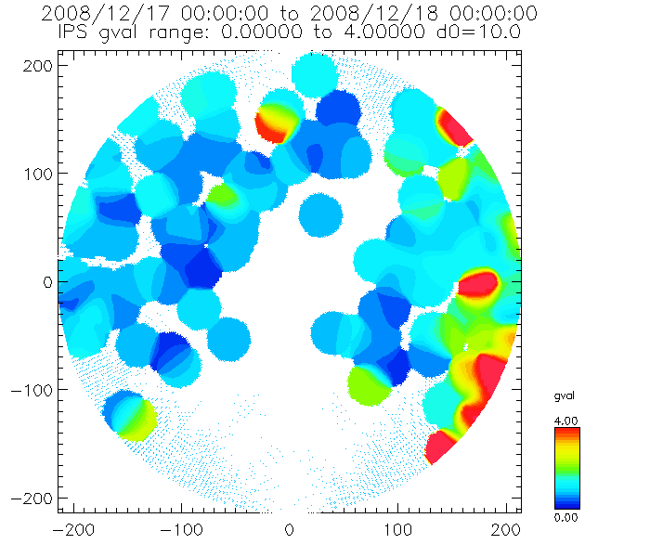
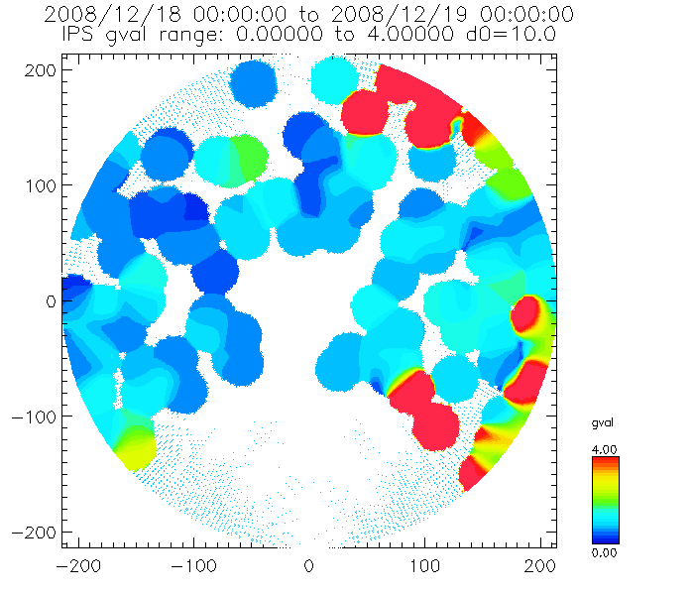
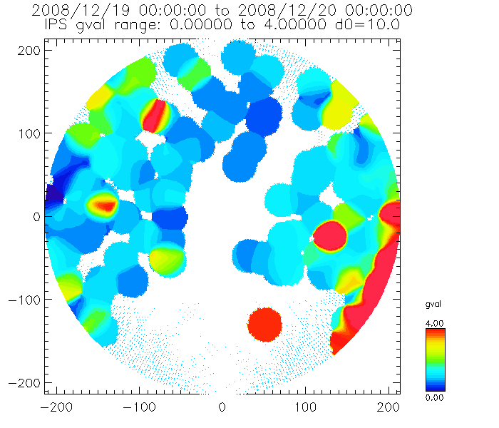
Tracking CMEs using Ooty Telescope
The scintillation g-index of a radio source (P.K. Manoharan et al, Solar Phys., 2006):
the ratio of observed scintillation to average expected scintillation
The sky map with the Sun in the center and the outer perimeter being at 90 degrees away from the Sun. The center represents the Sun-Earth line. The top points towards heliographic north, the bottom south. Angles from the Sun are translated into distance in R_S with 90 degrees corresponding to the Earth’s distance from the Sun.

Slide 15
Summery
We need more sources and probably higher time resolution of the IPS data to be able to track the CME propagation and accordingly prune the ensemble simulation

